Slide 1
Graphical User Interfaces

Slide 2
Design and code a GUI-based program
Define a new class using subclassing and inheritance
Instantiate and lay out different types of window components, such as labels, entry fields, and command buttons, in a window’s frame
Define methods that handle events associated with window components
Organize sets of window components in nested frames

Slide 3
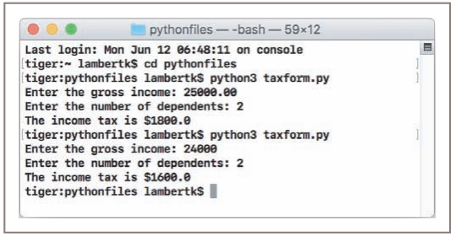
The Behavior of Terminal-Based Programs and GUI-Based Programs
A GUI program is event driven, meaning that it is inactive until the user clicks a button or selects a menu option
The Terminal-Based Version:

Slide 4
This terminal-based user interface has several obvious effects on its users:
• The user is constrained to reply to a definite sequence of prompts for inputs. Once an input is entered, there is no way to back up and change it.
• To obtain results for a different set of input data, the user must run the program again. At that point, all of the inputs must be re-entered.

Slide 5
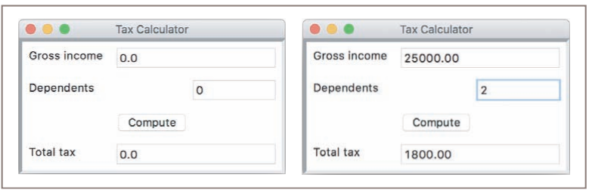
The GUI-Based Version
The GUI-based version of the program displays a window that contains various components, also called widgets.

Slide 6
The window in Figure contains the following components:
• A title bar at the top of the window. This bar contains the title of the program, “Tax Calculator.” It also contains three colored disks. Each disk is a command button. The user can use the mouse to click the left disk to quit the program, the middle disk to minimize the window, or the right disk to zoom the window. The user can also move the window around the screen by holding the left mouse button on the title bar and dragging the mouse.
• A set of labels along the left side of the window. These are text elements that describe the inputs and outputs. For example, “Gross income” is one label.
• A set of entry fields along the right side of the window. These are boxes within which the program can output text or receive it as input from the user. The first two entry fields will be used for inputs, while the last field will be used for the output. At program start-up, the fields contain default values, as shown in the window on the left side of Figure.
• A single command button labeled Compute. When the user uses the mouse to press this button, the program responds by using the data in the two input fields to compute the income tax. This result is then displayed in the output field. Sample input data and the corresponding output are shown in the window on the right side of Figure.
• The user can also alter the size of the window by holding the mouse on its lower-right corner and dragging in any direction.

Slide 7
Program explanation
The GUI in the program consists of the window and its components, including the labeled entry fields and the Compute button.
The action triggered when this button is clicked is a method call. This method fetches the input values from the input fields and performs the computation.
The result is then sent to the output field to be displayed.

Slide 8
Effects on users:
• The user is not constrained to enter inputs in a particular order. Before she presses the Compute button, she can edit any of the data in the two input fields.
• Running different data sets does not require re-entering all of the data. The user can edit just one value and press the Compute button to observe different results.

Slide 9
Event-Driven Programming
A GUI-based program opens a window and waits for the user to manipulate window components with the mouse. These user-generated events, such as mouse clicks, trigger operations in the program to respond by pulling in inputs, processing them, and displaying results.
This type of software system is event-driven, and the type of programming used to create it is called event-driven programming.

Slide 10
Once the interactions among these resources have been determined, their coding can begin.
This phase consists of several steps:
Define a new class to represent the main application window.
Instantiate the classes of window components needed for this application, such as labels, fields, and command buttons.
Position these components in the window.
Register a method with each window component in which an event relevant to the application might occur.
Define these methods to handle the events.
Define a main function that instantiates the window class and runs the appropriate method to launch the GUI.

Slide 11
Exercises
Describe two fundamental differences between terminal-based user interfaces and GUIs.
Give an example of one application for which a terminal-based user interface is adequate and one example that lends itself best to a GUI.

Slide 12
Coding Simple GUI-Based Programs
Python’s standard tkinter module includes classes for windows and numerous types of window components, but its use can be challenging for beginners.
An open-source module called breezypythongui, while occasionally relying upon some of the simpler resources of tkinter.
You will find the code, documentation, and installation instructions for the breezypythongui module at
http://home.wlu.edu/~lambertk/breezypythongui/

Slide 13
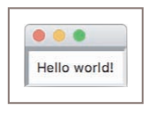
A Simple “Hello World” Program
Our first demo program defines a class for a main window that displays a greeting.

Slide 14
A new window class extends the EasyFrame class. By “extends,” we mean “repurposes” or “provides extra functionality for.”
The EasyFrame class provides the basic functionality for any window, such as the command buttons in the title bar.
Our new class, named LabelDemo, provides additional functionality to the EasyFrame class.

Slide 15
"""
File: labeldemo.py
"""
from breezypythongui import EasyFrame
class LabelDemo(EasyFrame):
def __init__(self):
EasyFrame.__init__(self)
self.addLabel(text = "Hello world!", row = 0, column = 0)
def main():
LabelDemo().mainloop()
if __name__ == "__main__":
main()

Slide 16
Import the EasyFrame class from the breezypythongui module. This class is a subclass of tkinter’s Frame class, which represents a top-level window. In many GUI programs, this is the only import that you will need.
Define the LabelDemo class as a subclass of EasyFrame. The LabelDemo class describes the window’s layout and functionality for this application.
Define an __init__ method in the LabelDemo class. This method is automatically run when the window is created. The __init__ method runs a method with the same name on the EasyFrame class and then sets up any window components to display in the window. In this case, the addLabel method is run on the window itself. The addLabel method creates a window component, a label object with the text “Hello world!,” and adds it to the window at the grid position (0, 0).
The last five lines of code define a main function and check to see if the Python code file is being run as a program. If this is true, the main function is called to create an instance of the LabelDemo class. The mainloop method is then run on this object. At this point, the window pops up for viewing. Note that mainloop, as the name implies, enters a loop. The Python Virtual Machine runs this loop behind the scenes. Its purpose is to wait for user events, as mentioned earlier. The loop terminates when the user clicks the window’s close box.

Slide 17
A Template for All GUI Programs
from breezypythongui import EasyFrame
Other imports
class ApplicationName(EasyFrame):
The __init__ method definition
Definitions of event handling methods
def main():
ApplicationName().mainloop()
if __name__ == "__main__":
main()

Slide 18
A GUI application window is always represented as a class that extends EasyFrame
The __init__ method initializes the window by setting its attributes and populating it with the appropriate GUI components.
Python runs this method automatically when the constructor function LabelDemo is called.
The last lines of code, beginning with the definition of the main function, create an instance of the application window class and run the mainloop method on this instance

Slide 19
The Syntax of Class and Method Definitions
Each definition has a one-line header that begins with a keyword (class or def), followed by a body of code indented one level in the text.
A class header contains the name of the class, conventionally capitalized in Python, followed by a parenthesized list of one or more parent classes.
The body of a class definition, nested one tab under the header, consists of one or more method definitions, which may appear in any order.
A method header looks very much like a function header, but a method always has at least one parameter, in the first position, named self.

Slide 20
For example, given the method header
def someMethod(self):
the method call
anObject.someMethod()
automatically assigns the object anObject to the self parameter for this method. The parameter self is used within class and method definitions to call other methods on the same object, or to access that object’s instance variables or data.

Slide 21
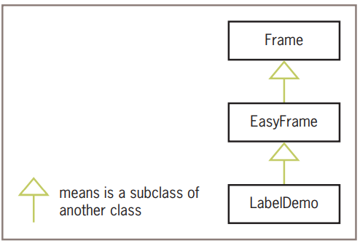
Subclassing and Inheritance as Abstraction Mechanisms

Slide 22
Exercises
Describe what usually happens in the __init__ method of a main window class.
Explain why it’s a good idea to make a new class a subclass of an existing class.

Slide 23
Windows and Window Components
Windows and Their Attributes
A window has several attributes. The most important ones are its
• title (an empty string by default)
• width and height in pixels
• resizability (true by default)
• background color (white by default)

Slide 24
We might override the dimensions and title of our first program’s window as follows:
EasyFrame.__init__(self, width = 300, height = 200, title = "Label Demo")
To access or modify an attribute, the programmer uses the standard subscript notation with the attribute name as a dictionary key. For example, later in the label demo’s __init__ method, the window’s background color can be set to yellow with the following statement:
self["background"] = "yellow"
Note that self in this case refers to the window itself.

Slide 25
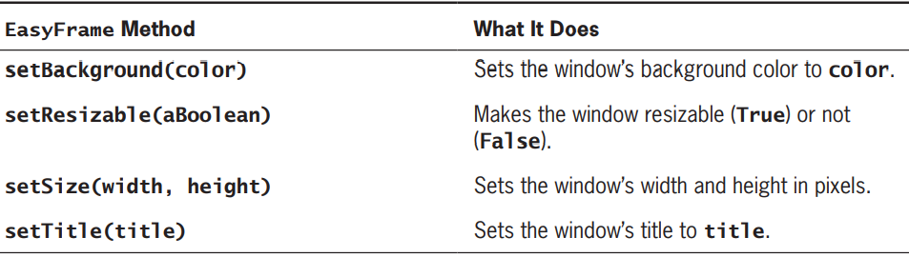
EasyFrame includes the four methods
For example, later in the LabelDemo class’s __init__ method, the window’s size can be permanently frozen with the following statement:
self.setResizable(False)

Slide 26
Window Layout
Window components are laid out in the window’s two-dimensional grid. The grid’s rows and columns are numbered from the position (0, 0) in the upper left corner of the window.
A window component’s row and column position in the grid is specified when the component is added to the window
class LayoutDemo(EasyFrame):
def __init__(self):
EasyFrame.__init__(self)
self.addLabel(text = "(0, 0)", row = 0, column = 0)
self.addLabel(text = "(0, 1)", row = 0, column = 1)
self.addLabel(text = "(1, 0)", row = 1, column = 0)
self.addLabel(text = "(1, 1)", row = 1, column = 1)

Slide 27
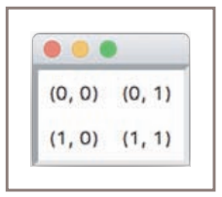
Laying out labels in the window’s grid

Slide 28
Each type of window component has a default alignment within its grid position and its is northwest.
The programmer can override the default alignment by including the sticky attribute as a keyword argument when the label is added to the window.
The values of sticky are the strings “N,” “S,” “E,” and “W,” or any combination
self.addLabel(text = "(0, 0)", row = 0, column = 0, sticky = "NSEW")
self.addLabel(text = "(0, 1)", row = 0, column = 1, sticky = "NSEW")
self.addLabel(text = "(1, 0)", row = 1, column = 0, sticky = "NSEW")
self.addLabel(text = "(1, 1)", row = 1, column = 1, sticky = "NSEW")

Slide 29
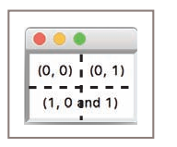
Spanning of a window component across several grid positions
code segment adds the three labels
self.addLabel(text = "(0, 0)", row = 0, column = 0, sticky = "NSEW")
self.addLabel(text = "(0, 1)", row = 0, column = 1, sticky = "NSEW")
self.addLabel(text = "(1, 0 and 1)", row = 1, column = 0, sticky = "NSEW", columnspan = 2)

Slide 30
Types of Window Components and Their Attributes
GUI programs use several types of window components which include labels, entry fields, text areas, command buttons, drop-down menus, sliding scales, scrolling list boxes, canvases, and many others.
The breezypythongui module includes methods for adding each type of window component to a window
self.addComponentType()

Slide 31
When this method is called, breeypythongui
• Creates an instance of the requested type of window component
• Initializes the component’s attributes with default values or any values provided by the programmer
• Places the component in its grid position (the row and column are required arguments)
• Returns a reference to the component
The window components supported by breezypythongui are either of the standard tkinter types, such as Label, Button, and Scale, or subclasses thereof, such as FloatField, TextArea, and EasyCanvas

Slide 32
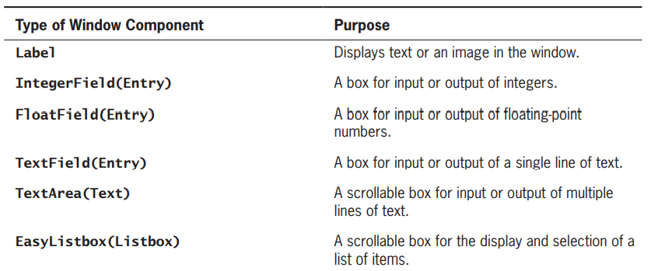

Slide 33
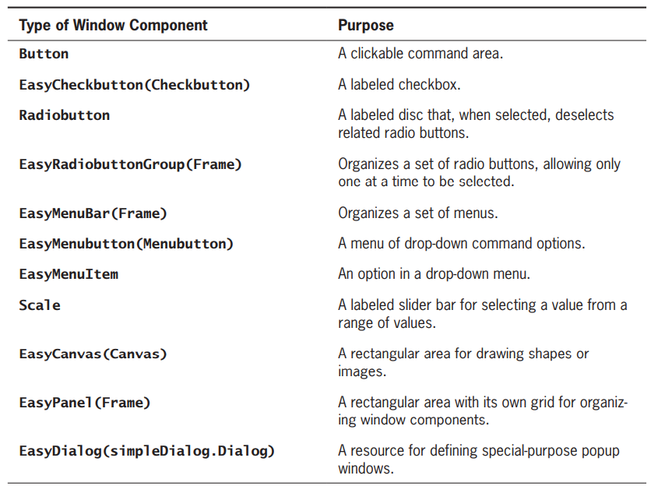

Slide 34
Displaying Images
To illustrate the use of attribute options for a label component, let’s examine a program (imagedemo.py) that displays an image with a caption
This program adds two labels to the window. One label displays the image and the other label displays the caption.
The image label is first added to the window with an empty text string. The program then creates a PhotoImage object from an image file and sets the image attribute of the image label to this object.
The image file must be in GIF format. Lastly, the program creates a Font object with a non-standard font and resets the text label’s font and foreground attributes to obtain the caption

Slide 35
from breezypythongui import EasyFrame
from tkinter import PhotoImage
from tkinter.font import Font
class ImageDemo(EasyFrame):
def __init__(self):
EasyFrame.__init__(self, title = "Image Demo")
self.setResizable(False);
imageLabel = self.addLabel(text = "", row = 0, column = 0, sticky = "NSEW")
textLabel = self.addLabel(text = "Smokey the cat", row = 1, column = 0, sticky = "NSEW")
self.image = PhotoImage(file = "smokey.gif")
imageLabel["image"] = self.image
font = Font(family = "Verdana", size = 20, slant = "italic")
textLabel["font"] = font
textLabel["foreground"] = "blue"

Slide 36
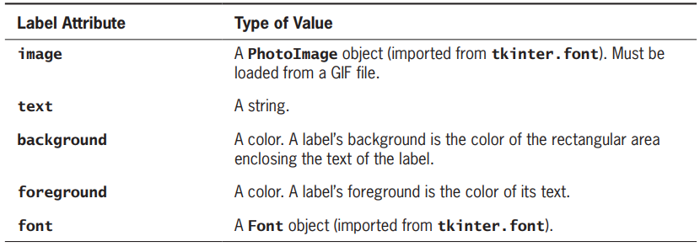
The tkinter.Label attributes

Slide 37
Additional information on Different types of window components
You are encouraged to browse the breezypythongui documentation for information on the different types of window components and their attributes. Python also has excellent documentation on the window components at
https://docs.python.org/3/library/tkinter.html#moduletkinter.
For an overview of fonts, see https://en.wikipedia.org/wiki/Font. Learning which fonts are available on your system requires some geekery with tkinter

Slide 38
Exercises
Write a code segment that centers the labels RED, WHITE, and BLUE vertically in a GUI window. The text of each label should have the color that it names, and the window’s background color should be green. The background color of each label should also be green.
Run the demo program fontdemo.py to explore the font families available on your system. Then write a code segment that centers the labels COURIER, HELVETICA, and TIMES horizontally in a GUI window. The text of each label should be the name of a font family. Substitute a different font family if necessary.
Write a code segment that uses a loop to create and place nine labels into a 3-by-3 grid. The text of each label should be its coordinates in the grid, starting with (0, 0) in the upper left corner. Each label should be centered in its grid cell. You should use a nested for loop in your code.
Jill has a plan for a window layout with two rows of widgets. The first row contains two widgets, and the second row contains four widgets. Describe how she can align the widgets so that they are evenly spaced in each row.
Describe the procedure for setting up the display of an image in a window.

Slide 39
Command Buttons and Responding to Events
A command button is added to a window just like a label, by specifying its text and position in the grid.
A button is centered in its grid position by default. The method addButton accomplishes all this and returns an object of type tkinter.Button.
Like a label, a button can display an image, usually a small icon, instead of a string.
A button also has a state attribute, which can be set to “normal” to enable the button (its default state) or “disabled” to disable it.

Slide 40
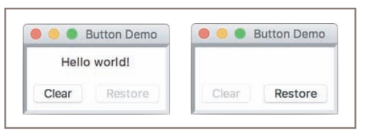
Figure shows these two states of the window

Slide 41
Program on Button
class ButtonDemo(EasyFrame):
def __init__(self):
EasyFrame.__init__(self)
self.label = self.addLabel(text = "Hello world!", row = 0, column = 0, columnspan = 2, sticky = "NSEW")
self.clearBtn = self.addButton(text = "Clear", row = 1, column = 0)
self.restoreBtn = self.addButton(text = "Restore", row = 1, column = 1, state = "disabled")
Note that the Restore button, which appears in gray in the window on the left, is initially disabled.

Slide 42
To allow a program to respond to a button click, the programmer must set the button’s command attribute.
There are two ways to do this:
either by supplying a keyword argument when the button is added to the window or, later, by assignment to the button’s attribute dictionary.
The value of the command attribute should be a method of no arguments, defined in the program’s window class.
The default value of this attribute is a method that does nothing.

Slide 43
class ButtonDemo(EasyFrame):
def __init__(self):
EasyFrame.__init__(self)
self.label = self.addLabel(text = "Hello world!", row = 0, column = 0, columnspan = 2, sticky = "NSEW")
self.clearBtn = self.addButton(text = "Clear", row = 1, column = 0, command = self.clear)
self.restoreBtn = self.addButton(text = "Restore", row = 1, column = 1, state = "disabled", command = self.restore)
def clear(self):
self.label["text"] = ""
self.clearBtn["state"] = "disabled"
self.restoreBtn["state"] = "normal"
def restore(self):
self.label["text"] = "Hello world!"
self.clearBtn["state"] = "normal"
self.restoreBtn["state"] = "disabled"

Slide 44
Exercises
Explain what happens when a user clicks a command button in a fully functioning GUI program.
Why is it a good idea to write and test the code for laying out a window’s components before you add the methods that perform computations in response to events?

Slide 45
Input and Output with Entry Fields
An entry field is a box in which the user can position the mouse cursor and enter a number or a single line of text.
Text Fields:
A text field is appropriate for entering or displaying a single-line string of characters.
The programmer uses the method addTextField to add a text field to a window. The method returns an object of type TextField, which is a subclass of tkinter.Entry. Required arguments to addTextField are text (the string to be initially displayed), row, and column. Optional arguments are rowspan, columnspan, sticky, width, and state.
A text field is aligned by default to the northeast of its grid cell.
A text field has a default width of 20 characters.

Slide 46
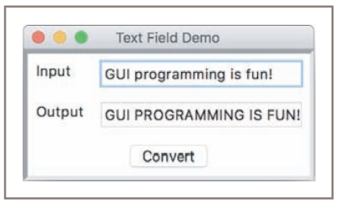
The programmer can set a text field’s state attribute to “readonly” to prevent the user from editing an output field.
The TextField method getText returns the string currently contained in a text field. Thus, it serves as an input operation.
The method setText outputs its string argument to a text field.

Slide 47
Program
class TextFieldDemo(EasyFrame)
def __init__(self):
EasyFrame.__init__(self, title = "Text Field Demo”)
self.addLabel(text = "Input", row = 0, column = 0)
self.inputField = self.addTextField(text = "", row = 0, column = 1)
self.addLabel(text = "Output", row = 1, column = 0)
self.outputField = self.addTextField(text = "", row = 1, column = 1, state = "readonly”)
self.addButton(text = "Convert", row = 2, column = 0, columnspan = 2,command = self.convert)
def convert(self):
text = self.inputField.getText()
result = text.upper()
self.outputField.setText(result)

Slide 48
Terminal-based program
similar to the logic of the following, ridiculously simple, terminal-based program:
text = input("Input: ")
result = text.upper()
print("Output:", result)

Slide 49
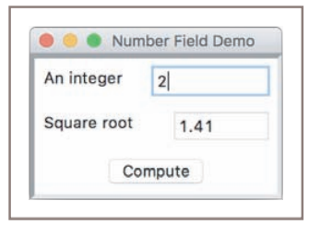
Integer and Float Fields for Numeric Data

Slide 50
Program
class NumberFieldDemo(EasyFrame)
def __init__(self):
EasyFrame.__init__(self, title = "Number Field Demo")
self.addLabel(text = "An integer", row = 0, column = 0) self.inputField = self.addIntegerField(value = 0, row = 0, column = 1,
width = 10)
self.addLabel(text = "Square root", row = 1, column = 0) self.outputField = self.addFloatField(value = 0.0, row = 1,column = 1,width = 8, precision = 2, state = "readonly")
self.addButton(text = "Compute", row = 2, column = 0,columnspan = 2, command = self.computeSqrt)
def computeSqrt(self):
number = self.inputField.getNumber()
result =math.sqrt(number)
self.outputField.setNumber(result)

Slide 51
Using Pop-Up Message Boxes
When errors arise in a GUI-based program, the program often responds by popping up a dialog window with an error message.
Such errors are usually the result of invalid input data. The program detects the error, pops up the dialog to inform the user, and, when the user closes the dialog, continues to accept and check input data.
Python raises an exception or runtime error when these events occur by try-except statement.
try:
<statements that might raise an exception>
except <exception type>:
<statements to recover from the exception>

Slide 52
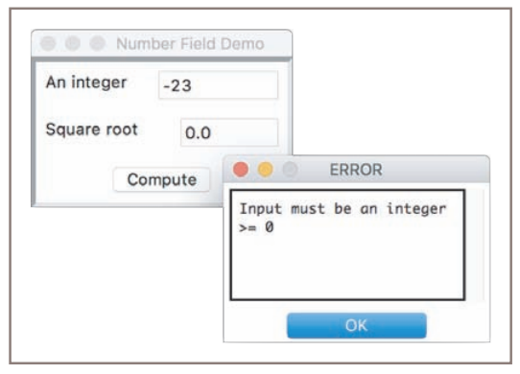

Slide 53
Program
def computeSqrt(self):
try:
number = self.inputField.getNumber()
result = math.sqrt(number)
self.outputField.setNumber(result)
except ValueError:
self.messageBox(title = "ERROR", message = "Input must be an integer >= 0")

Slide 54
Exercises
Explain why you would not use a text field to perform input and output of numbers.
Write a line of code that adds a FloatField to a window, at position (1, 1) in the grid, with an initial value of 0.0, a width of 15, and a precision of 2.
What happens when you enter a number with a decimal point into an IntegerField?
When would you make a data field read-only, and how would you do this?
Explain what happens when a program receives a non-numeric string when a number is expected as input, and explain how the try-except statement can be of use in this situation

Slide 55
Defining and Using Instance Variables
Earlier we said that methods use the parameter self to call other methods in an object’s class or to access that object’s instance variables.
An instance variable is used to store data belonging to an individual object.
The window class’s __init__ method establishes the initial state of a window object when it is created, and other methods within that class are run to access or modify this state (to make the window larger, change its title, or respond to an event).
These basic elements of a window’s state are defined and managed in the classes breezypythongui.EasyFrame and tkinter.frame.

Slide 56
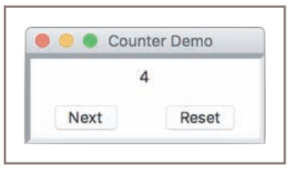
The GUI for a counter application
At start-up, the window displays a label of 0 and two buttons named Next and Reset. When the user clicks Next, the window increments the number in the label; when the user clicks Reset, the window resets the label to 0.

Slide 57
Program
class CounterDemo(EasyFrame):
def __init__(self):
EasyFrame.__init__(self, title = "Counter Demo")
self.setSize(200, 75)
self.count = 0
self.label = self.addLabel(text = "0", row = 0, column = 0, sticky = "NSEW", columnspan= 2)
self.addButton(text = "Next", row = 1, column = 0, command = self.next)
self.addButton(text = "Reset", row = 1, column = 1, command = self.reset)
def next(self):
self.count += 1
self.label["text"] = str(self.count)
def reset(self):
self.count = 0
self.label["text"] = str(self.count)

Slide 58
Exercises
What is meant by the state of an object, and how does the programmer access and manipulate it?
Explain the differences between instance variables and temporary variables. Focus on their visibility in a class definition, and on their roles in managing data for an object of that class.
Explain the purpose of the variable self in a Python class definition.

Slide 59
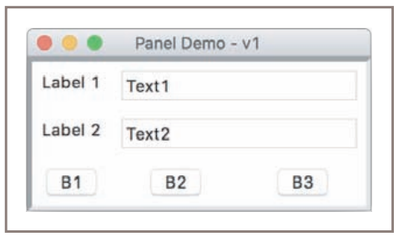
Other Useful GUI Resources
Using Nested Frames to Organize Components:
Suppose that a GUI requires a row of three command buttons beneath two columns of labels and text fields.
The layout is not ragged, but if you look closely, the buttons in the bottom row are unevenly spaced.

Slide 60
A more natural design decomposes the window into two nested frames, sometimes called panels.
Each panel contains its own independent grid. The top panel contains a 2-by-2 grid of labels and entry fields, whereas the bottom panel contains a 1-by-3 grid of buttons.
The breezypythongui method addPanel adds a panel to the window at a given row and column in the window’s grid.
This method returns an instance of the EasyPanel class, so you can add widgets to it just as if it were a top-level window.
Because EasyPanel is a descendant of the tkinter.Frame class, and has almost the same interface as the EasyFrame class, you can run many of the same methods on a panel object that you run on a top-level window object.

Slide 61
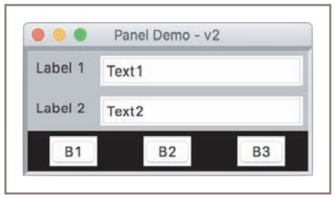
we have added background colors gray and black to the panels for emphasis.

Slide 62
Program on Panel
class PanelDemo(EasyFrame):
def __init__(self):
EasyFrame.__init__(self, "Panel Demo - v2")
dataPanel = self.addPanel(row = 0, column = 0, background = "gray") dataPanel.addLabel(text = "Label 1", row = 0, column = 0,background = "gray")
dataPanel.addTextField(text = "Text1", row = 0, column = 1) dataPanel.addLabel(text = "Label 2", row = 1, column = 0,background = "gray")
dataPanel.addTextField(text = "Text2", row = 1, column = 1)
buttonPanel = self.addPanel(row = 1, column = 0, background = "black")
buttonPanel.addButton(text = "B1", row = 0, column = 0) buttonPanel.addButton(text = "B2", row = 0, column = 1) buttonPanel.addButton(text = "B3", row = 0, column = 2)

Slide 63
Multi-Line Text Areas
A text area widget allows the program to output and the user to input and edit multiple lines of text.
The method addTextArea adds a text area to the window. The required arguments are the initial text to display, the row, and the column.
Optional arguments include a width and height in columns (characters) and rows (lines), with defaults of 80 and 5, respectively.
The final optional argument is called wrap. This argument tells the text area what to do with a line of text when it reaches the right border of the viewable area. The default value of wrap is “none,” which causes a line of text to continue invisibly beyond the right border.
The other values are “word” and “char,” which break a line at a word or a character, and continue the text on the next line.

Slide 64
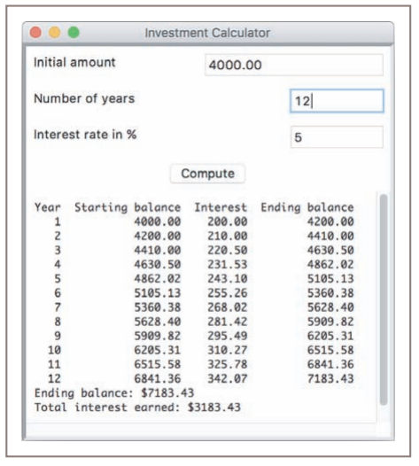
The addTextArea method returns an object of type TextArea, a subclass of tkinter.Text. This object recognizes three important methods: getText, setText, and appendText.
Displaying data in a multi-line text area

Slide 65
Program on TextAreaDemo
class TextAreaDemo(EasyFrame):
def __init__(self):
EasyFrame.__init__(self, "Investment Calculator")
self.addLabel(text = "Initial amount", row = 0, column = 0)
self.addLabel(text = "Number of years", row = 1, column = 0)
self.addLabel(text = "Interest rate in %", row = 2, column = 0)
self.amount = self.addFloatField(value = 0.0, row = 0, column = 1)
self.period = self.addIntegerField(value = 0, row = 1, column = 1)
self.rate = self.addIntegerField(value = 0, row = 2, column = 1)
self.outputArea = self.addTextArea("", row = 4, column = 0, columnspan = 2, width = 50, height = 15)
self.compute = self.addButton(text = "Compute", row = 3, column = 0, columnspan = 2, command = self.compute)

Slide 66
def compute(self):
startBalance = self.amount.getNumber()
rate = self.rate.getNumber() / 100
years = self.period.getNumber()
if startBalance == 0 or rate == 0 or years == 0:
return
result = "%4s%18s%10s%16s\n" % ("Year", "Starting balance", "Interest", "Ending balance") totalInterest = 0.0
for year in range(1, years + 1):
interest = startBalance * rate
endBalance = startBalance + interest
result += "%4d%18.2f%10.2f%16.2f\n" % \ (year, startBalance, interest, endBalance) startBalance = endBalance
totalInterest += interest
result += "Ending balance: $%0.2f\n" % endBalance
result += "Total interest earned: $%0.2f\n" % totalInterest
self.outputArea["state"] = "normal"
self.outputArea.setText(result)
self.outputArea["state"] = "disabled"

Slide 67
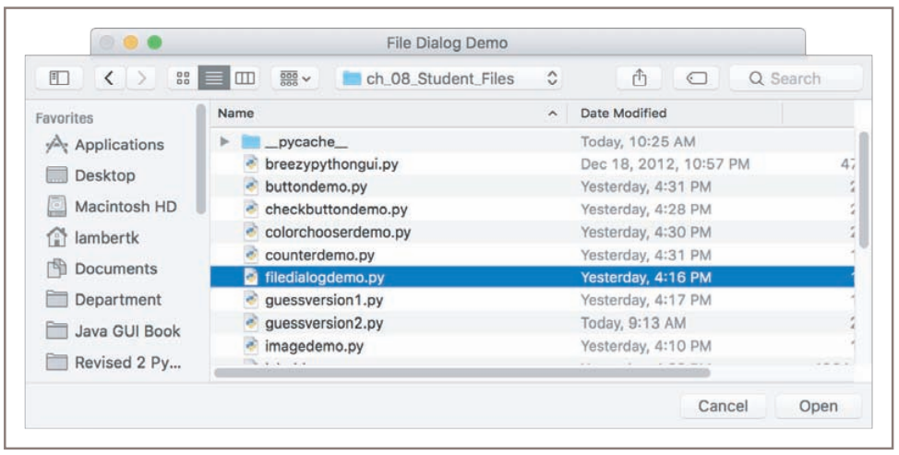
File Dialogs
GUI-based programs allow the user to browse the computer’s file system with file dialogs

Slide 68
Python’s tkinter.filedialog module includes two functions, askopenfilename and asksaveasfilename, to support file access in a GUI-based program.
Each function pops up the standard file dialog for the user’s particular computer system. If the user selects the dialog’s Cancel button, the function returns the empty string. Otherwise, when the user selects the Open or Save button, the function returns the full pathname of the file that the user has selected (opening or saving) or entered as input (saving only) in the dialog.
The program can then use the filename to open the file for input or output in the usual manner.
we use the following syntax with these two functions:
fList = [("Python files", "*.py"), ("Text files", "*.txt")]
filename = tkinter.filedialog.askopenfilename(parent = self, filetypes = fList)
filename = tkinter.filedialog.asksaveasfilename(parent = self)

Slide 69
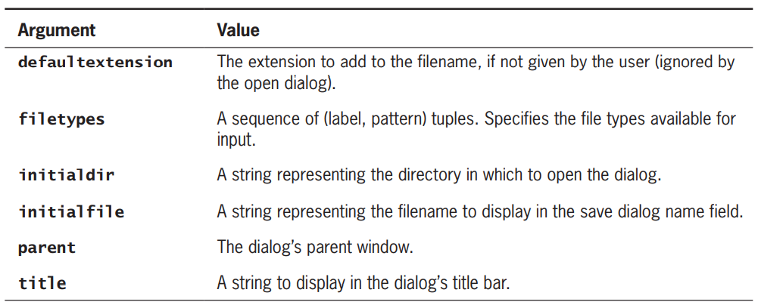
List of all the optional arguments for the two file dialog functions.

Slide 70
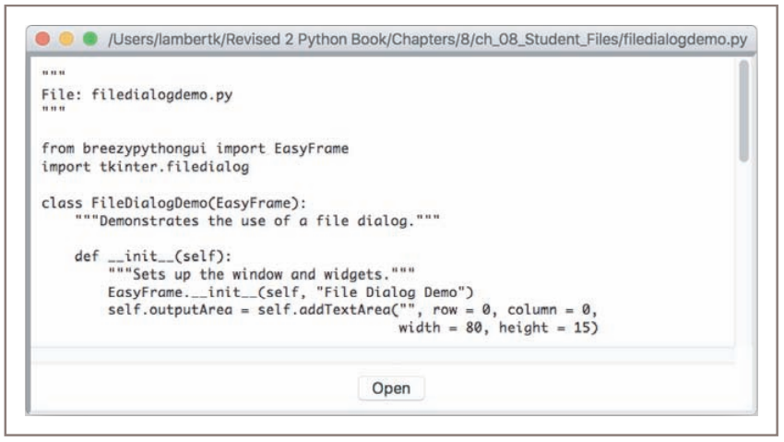
You can use a file dialog and a text area to create a simple browser that allows the user to view text files.

Slide 71
Program for the Window class
from breezypythongui import EasyFrame
import tkinter.filedialog
class FileDialogDemo(EasyFrame):
def __init__(self):
EasyFrame.__init__(self, "File Dialog Demo")
self.outputArea = self.addTextArea("", row = 0, column = 0, width = 80, height = 15)
self.addButton(text = "Open", row = 1, column = 0, command = self.openFile)
def openFile(self)
fList = [("Python files", "*.py"), ("Text files", "*.txt")]
fileName = tkinter.filedialog.askopenfilename(parent = self, filetypes = fList)
if fileName != "":
file = open(fileName, 'r’)
text = file.read()
file.close()
self.outputArea.setText(text)
self.setTitle(fileName)

Slide 72
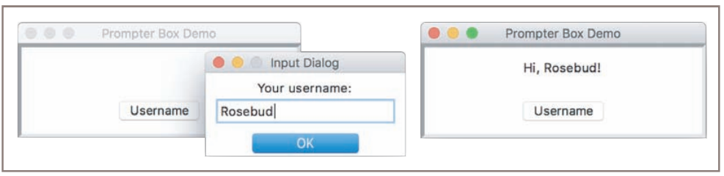
Obtaining Input with Prompter Boxes
GUI applications use a popup dialog called a prompter box for this purpose.

Slide 73
The prompter box displays a title, a message for the prompt, an entry field for the user’s input, and a button to submit the input. The entry field can have some optional initial text.
You popup a prompter box by calling the EasyFrame method prompterBox with the appropriate arguments. When the user closes the dialog by clicking the OK button or the dialog’s close disc, the method returns the contents of the entry field.

Slide 74
class PrompterBoxDemo(EasyFrame):
def __init__(self):
EasyFrame.__init__(self, title = "Prompter Box Demo", width = 300, height = 100) self.label = self.addLabel(text = "", row = 0, column = 0, sticky = "NSEW")
self.addButton(text = "Username", row = 1, column = 0, command = self.getUserName)
def getUserName(self):
text = self.prompterBox(title = "Input Dialog", promptString = "Your username:") self.label["text"] = "Hi " + text + "!"

Slide 75
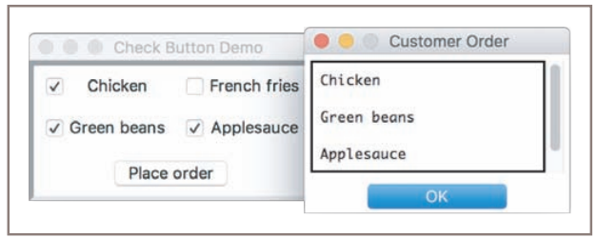
Check Buttons
A check button consists of a label and a box that a user can select or deselect with the mouse. Check buttons often represent a group of several options, any number of which may be selected at the same time.

Slide 76
The method addCheckbutton expects a text argument (the button’s label) and an optional command argument (a method to be triggered when the user checks or unchecks the button), and returns an object of type EasyCheckbutton. The EasyCheckbutton method isChecked returns True if the button is checked, or False otherwise.
Program:
class CheckbuttonDemo(EasyFrame):
def __init__(self):
EasyFrame.__init__(self, "Check Button Demo")
self.chickCB = self.addCheckbutton(text = "Chicken", row = 0, column = 0)
self.taterCB = self.addCheckbutton(text = "French fries", row = 0, column = 1) self.beanCB = self.addCheckbutton(text = "Green beans", row = 1, column = 0) self.sauceCB = self.addCheckbutton(text = "Applesauce", row = 1, column = 1)
self.addButton(text = "Place order", row = 2, column = 0, columnspan = 2, command = self.placeOrder)

Slide 77
def placeOrder(self):
message = ""
if self.chickCB.isChecked():
message += "Chicken\n\n"
if self.taterCB.isChecked():
message += "French fries\n\n"
if self.beanCB.isChecked():
message += "Green beans\n\n"
if self.sauceCB.isChecked():
message += "Applesauce\n"
if message == "":
message = "No food ordered!"
self.messageBox(title = "Customer Order", message = message)

Slide 78
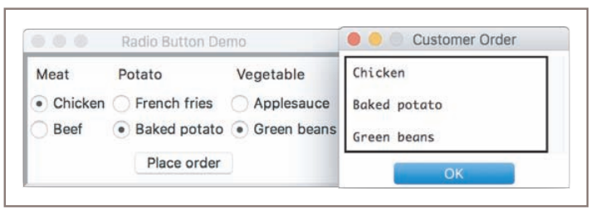
Radio Buttons
Check buttons allow a user to select multiple options in any combination. When the user must be restricted to one selection only, the set of options can be presented as a group of radio buttons. Like a check button, a radio button consists of a label and a control widget. One of the buttons is normally selected by default at program start-up. When the user selects a different button in the same group, the previously selected button automatically deselects.

Slide 79
To add radio buttons to a window,
The programmer first adds the radio button group to which these buttons will belong. The method addRadiobuttonGroup expects the grid coordinates as required arguments.
Optional arguments are orient (whose default is “vertical”), rowspan, and columnspan. In the case of a vertically aligned button group, rowspan should be set to the number of buttons, and columnspan should be likewise set for a horizontally aligned group.
The method returns an object of type EasyRadiobuttonGroup, which is a subclass of tkinter.Frame. This allows the programmer to place a custom background color in the region of the button group.

Slide 80
The EasyRadiobuttonGroup method getSelectedButton returns the currently selected radio button in a radio button group.
The method setSelectedButton selects a radio button under program control.
Once a radio button group is created, the programmer can add radio buttons to it with the EasyRadiobuttonGroup method addRadiobutton.
This method expects a text argument (the button’s label) and an optional command argument (a zero-argument method to be triggered when the button is selected).
The method returns an object of type tkinter.Radiobutton.

Slide 81
Program
class RadiobuttonDemo(EasyFrame):
def __init__(self):
EasyFrame.__init__(self, "Radio Button Demo")
self.addLabel(text = "Meat", row = 0, column = 0)
self.meatGroup = self.addRadiobuttonGroup(row = 1, column = 0, rowspan = 2) defaultRB = self.meatGroup.addRadiobutton(text = "Chicken") self.meatGroup.setSelectedButton(defaultRB)
self.meatGroup.addRadiobutton(text ="Beef")
self.addLabel(text = "Potato", row = 0, column = 1)
self.taterGroup = self.addRadiobuttonGroup(row = 1, column = 1, rowspan = 2) defaultRB = self.taterGroup.addRadiobutton(text = "French fries") self.taterGroup.setSelectedButton(defaultRB)
self.taterGroup.addRadiobutton(text = "Baked potato")

Slide 82
self.addLabel(text = "Vegetable", row = 0, column = 2)
self.vegGroup = self.addRadiobuttonGroup(row = 1, column = 2, rowspan = 2)
defaultRB = self.vegGroup.addRadiobutton(text = "Applesauce") self.vegGroup.setSelectedButton(defaultRB)
self.vegGroup.addRadiobutton(text = "Green beans")
self.addButton(text = "Place order", row = 3, column = 0, columnspan = 3, command =self.placeOrder)
def placeOrder(self):
message = ""
message += self.meatGroup.getSelectedButton()["text"] + "\n\n"
message += self.taterGroup.getSelectedButton()["text"] + "\n\n"
message += self.vegGroup.getSelectedButton()["text"]
self.messageBox(title = "Customer Order", message = message)

Slide 83
Thank You

